Slide 1
Amazon Product Ratings
Data Analysis

Slide 2
Key Areas of Focus
Metric
Dimensions
Dataset
Ratings have been considered as the north-star metric as it acts as an indicator of customer satisfaction and likeliness of a product.
Product
Product Category
Price
Rating
Review
The analysis is based on a data of 1465 different amazon product listings. The total rating count exceed 5 million.

Slide 3
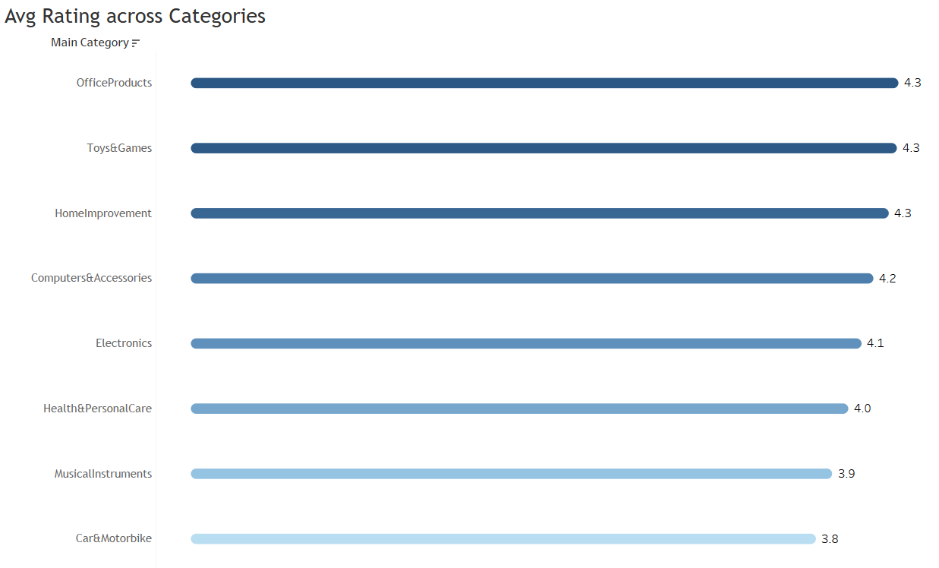
Avg Rating across Categories
Office Products along with Toys Games and Home Improvement are the highest rated product categories on Amazon.

Slide 4
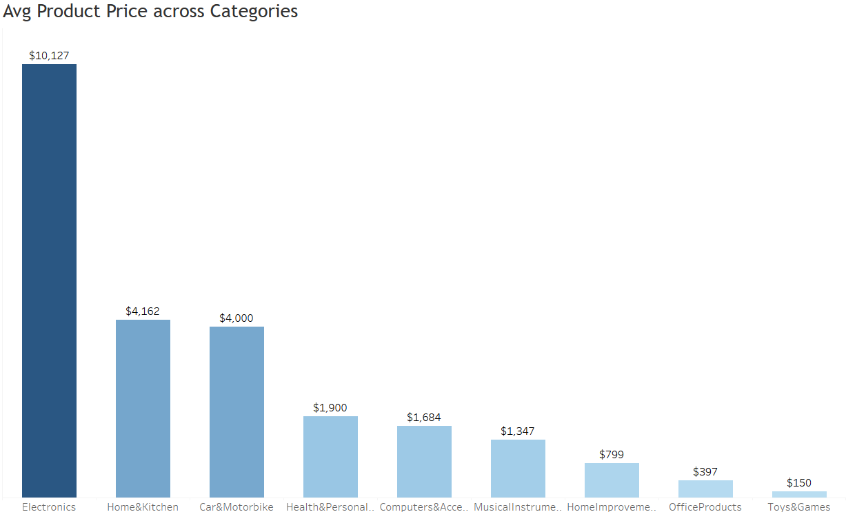
Avg Product Price across Categories
Metric
Dimensions
Electronic products have high product prices whereas other categories are far behind.

Slide 5
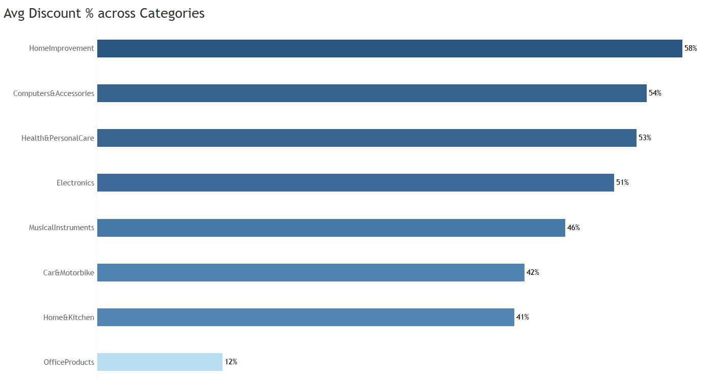
Discount by Product Category
Home Improvement products have the most discount whereas Office Products have the least.
Dimensions

Slide 6
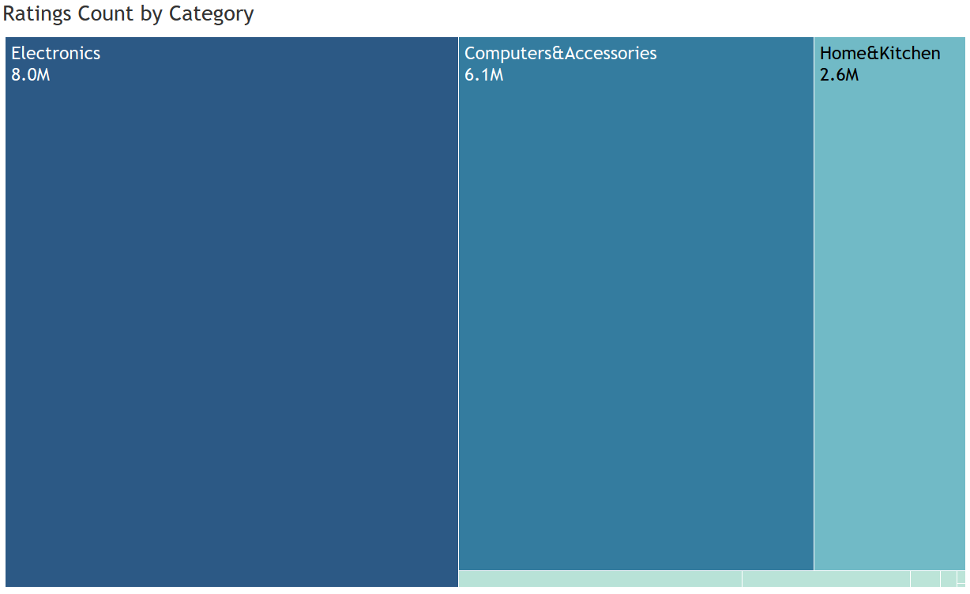
Ratings Count by Category
Metric
Dimensions
Electronics and Computer & Accessories lead the category list in Rating Count.

Slide 7
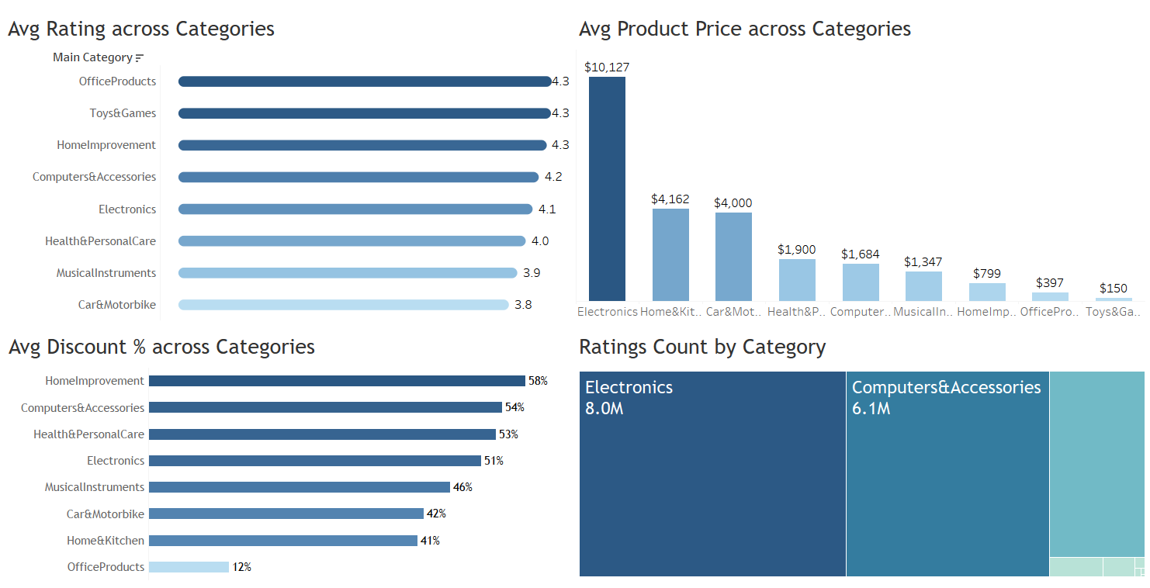
Amazon Product Ratings Dashboard

Slide 8
Key Insights
Products
Categories
Customer Satisfaction
Electronic products, which have higher prices, tend to receive diverse ratings, indicating that customers have varying expectations based on the price point.
Office Products, Toys & Games, and Home Improvement categories are the highest-rated on Amazon. These categories likely meet or exceed customer expectations consistently, leading to higher satisfaction rates.
Customer satisfaction does not always correlate with higher prices. While high-priced electronics receive a lot of attention, their ratings vary, indicating that value for money is a crucial factor in customer satisfaction.

Slide 9
Thank You

